Slide 1
Disaster

Slide 3
Every year on all Earth occurs about one million earthquakes, but the majority of them so are insignificant that they remain not noticed. Really strong earthquakes, capable to cause extensive destructions, happen on a planet about time in two weeks. Their big part is necessary on a bottom of oceans and consequently it is not accompanied by catastrophic consequences (if earthquake under ocean does without a tsunami).

Slide 5
Flooding — considerably big flooding by water of district as a result of water level lifting in the river, lake or the sea, caused by the various reasons. Flooding on the river occurs from sharp increase of a quantity of water owing to thawing of snow or the glaciers located in its pool, and also as a result of loss of plentiful deposits.

Slide 7
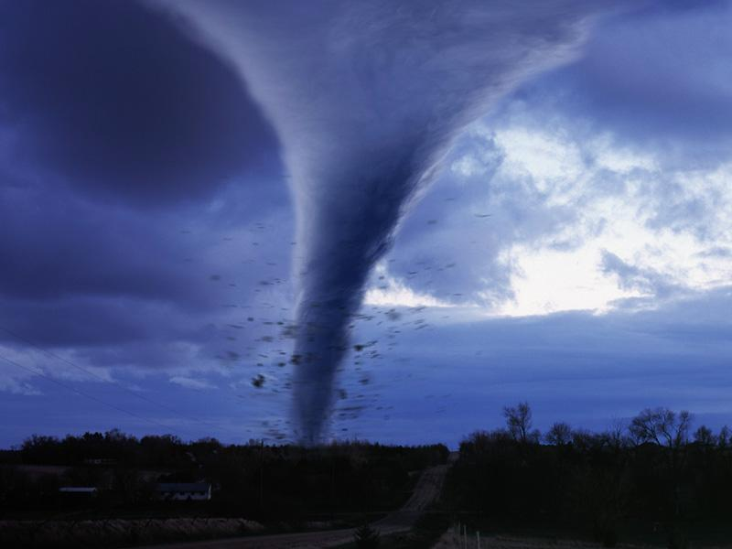
Tornado

Slide 8
Tornado - the dangerous natural phenomenon arising between heaven and earth (water). The tornado destroys all houses, plants, cars...

Slide 10
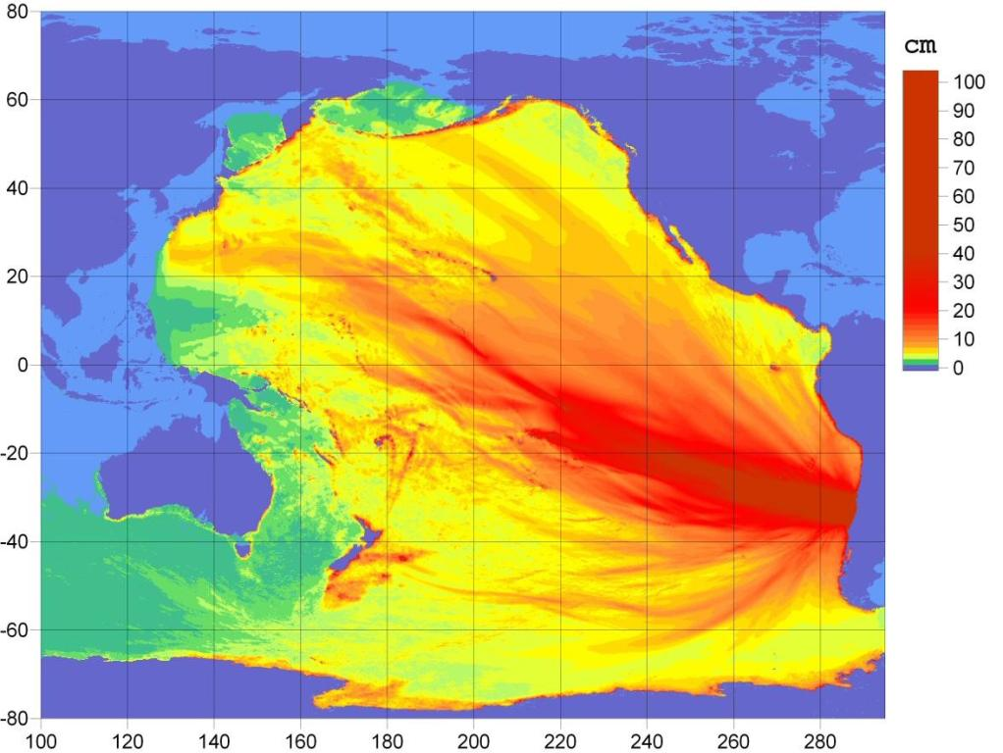
Tsunami

Slide 11
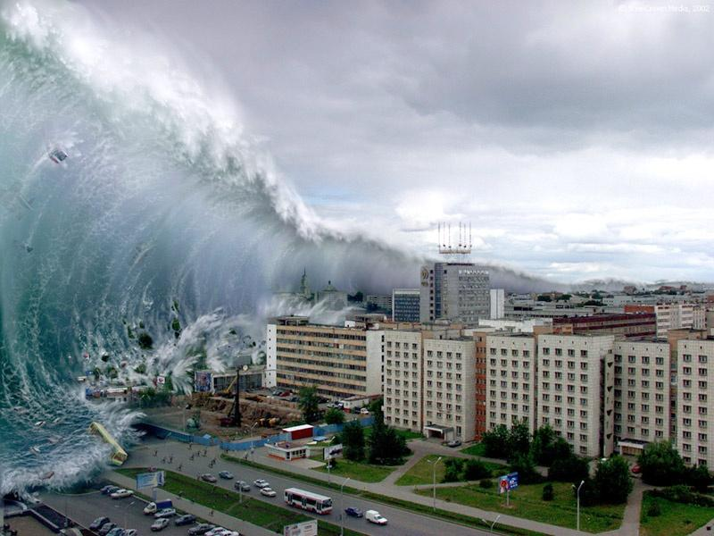
Tsunami - the big wave reaching in height to 100 meters, also can cover a huge part of a land.

Slide 12
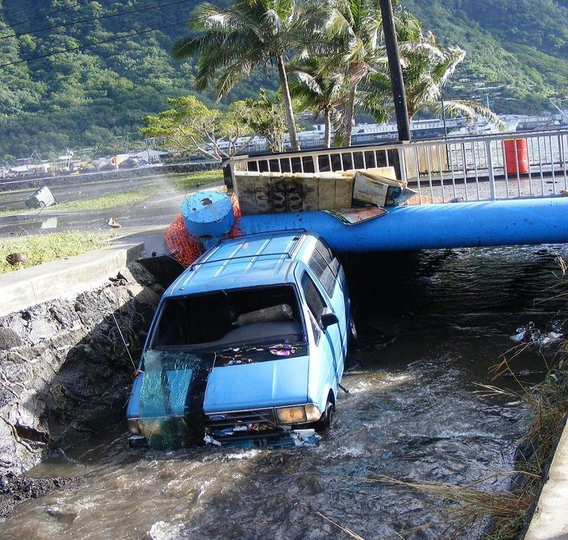
Consequences after accidents are very awful and tragic.

